Slide 1
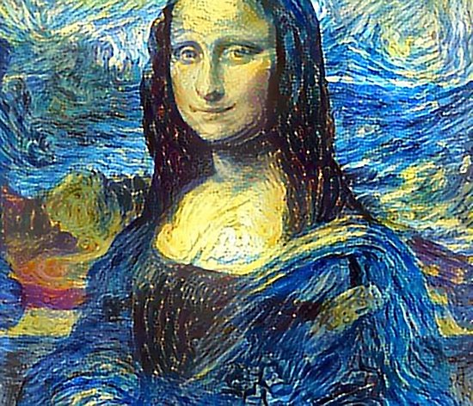
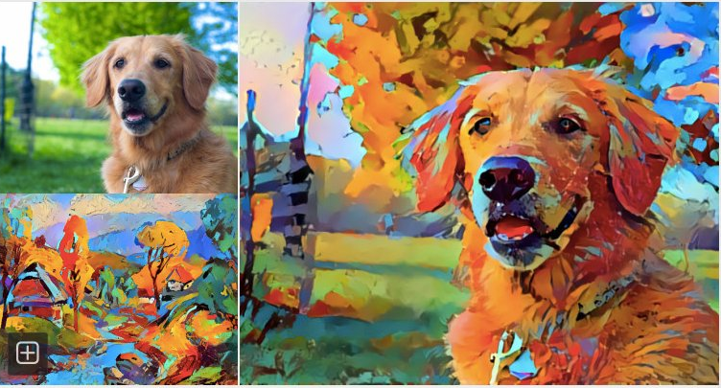
Temporal cycle consistency: for video to video translation
By Kirubel Abebe
Advisor :Prof Yun Koo Chung.
Draft Thesis proposal presentation
2019

Slide 2
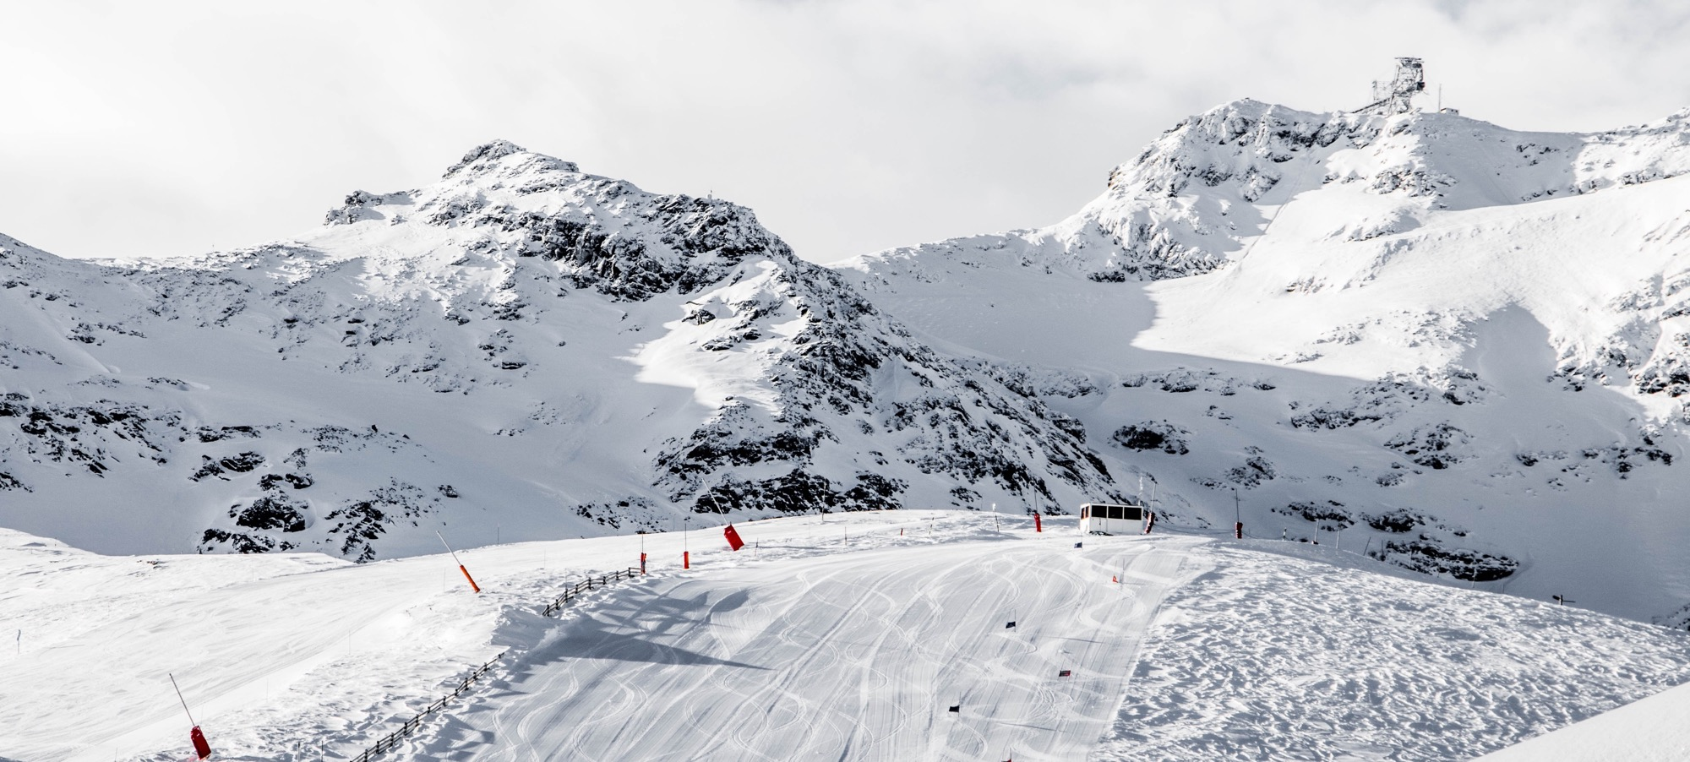

Temporal cycle consistency:
Outlines
Introduction
Background
Literature review
Research question
Conceptual framework
for video to video translation
Notes:
© Copyright Showeet.com – Free PowerPoint Templates

Slide 3
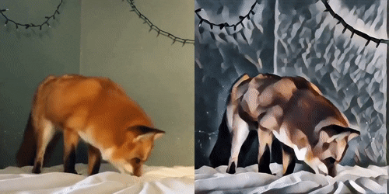
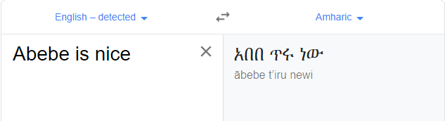
Introduction
Video to video Translation: transferring of sequential content information form one domain to another.
While preserving the content of source domain and style of the target domain .
Source
style
Notes:
© Copyright Showeet.com – Free PowerPoint Templates

Slide 4
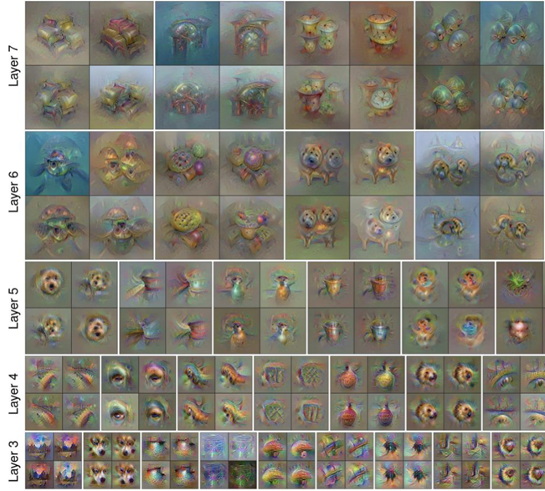
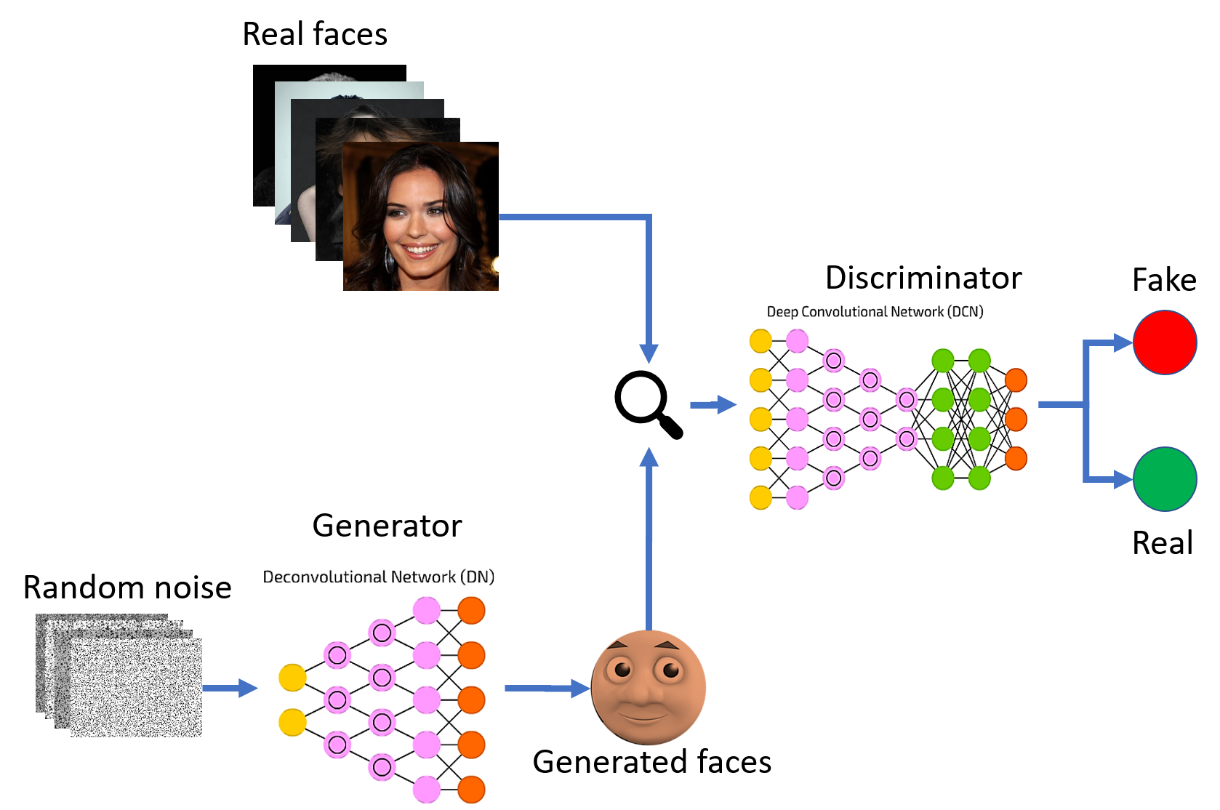
Given a feature vector for an image, find a new image such that
Background
(GAN)
Its features are similar to the given features
It “looks natural”
Notes:
Given a feature vector for an image, find a new image such that

Slide 5
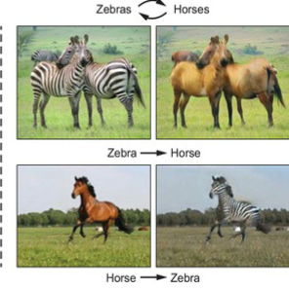
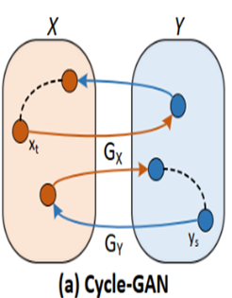

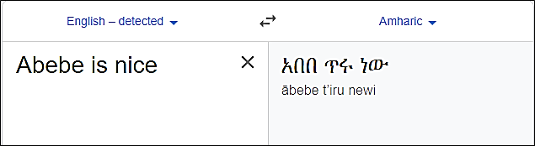
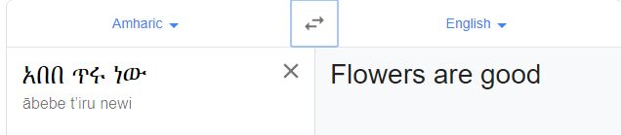
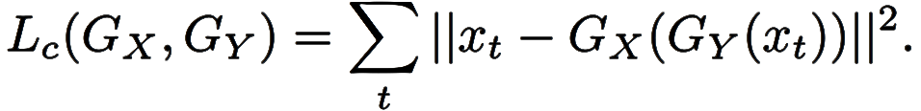
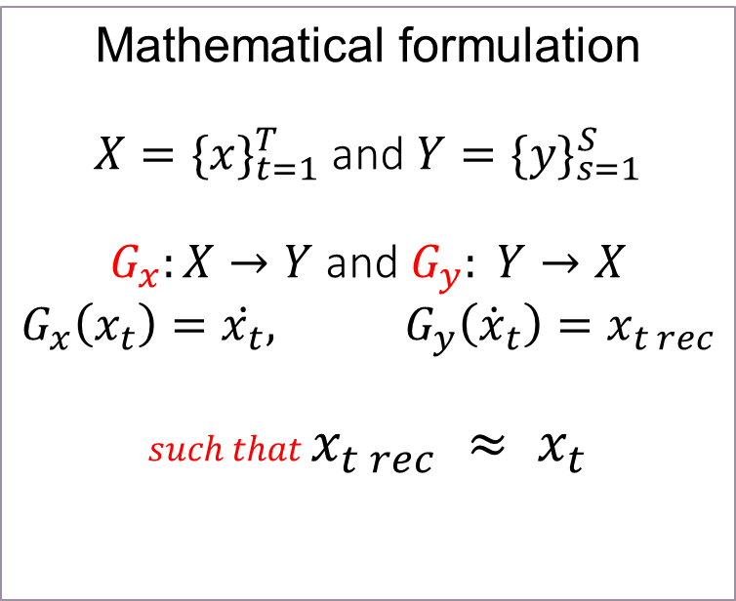
Background
Cycle GAN: Cycle consistency constraint
Mathematical formulation
$X=\{x\}_{t=1}^{T}$ and $Y=\{y\}_{s=1}^{S}$
$G_{x}:X→Y$ and $G_{y}: Y→X$
$$G_{x}\left(x_{t}\right)=\dot{x_{t}}, G_{y}\left({\dot{x}}_{t}\right)=x_{t rec}$$
$such that$ $x_{t rec} ≈ x_{t}$
Notes:
cycle constraint enable image to image translation in both forward and backward mapping

Slide 6
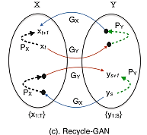
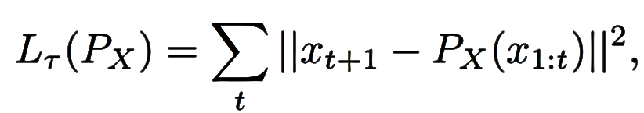
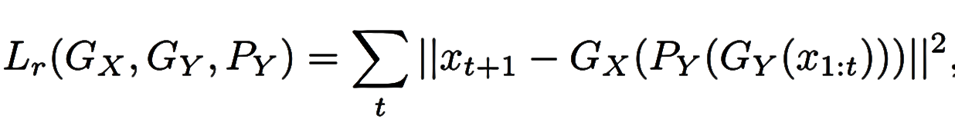
Recycel GAN
Background
Cycle GAN + Temporal Predictor = Recycle GAN
Mathematical formulation
Notes:
© Copyright Showeet.com – Free PowerPoint Templates

Slide 7
Motivations
“unpaired and unsupervised video retargeting and image translation is an under-constrained problem”. (Bansal et al., 2018)
Flickering problem.
Better color mapping.

Slide 8
Research Question
Here are research question
What is the effective temporal consistency constraint for video to video translation?
What is the effect of Temporal cycle consistency for video translation impact on unsupervised video to video transfer?
Review power of 3D spatiotemporal constraint for better color preservation.

Slide 9
General Objective
Design and implement Spatiotemporal 3D unsupervised video to video translation for video retargeting. This proposal aims extension of (Bansal et al., 2018) ReCycle GAN.

Slide 10
Specific Objective
Here are list of specific objective
To preprocess dataset in order to enhance its quality.
To design an effective technique to extract temporal information video.
To evaluate 3D spatiotemporal video translation.
To design deep learning model using keras and TensorFlow framework.
To design spatial Temporal fusion.
To test the trained model with test set.
To evaluate the performance of the system.

Slide 11
Scope
Here are list of scope of research
preprocessing the dataset
Train to model and present accuracy of implemented proposed work
Occlusion problem is not considered
Limitation
This work may not archive its best because of computational constraint

Slide 12
Literature review
Author and Title | Methodology | Objective | GAP(future work)
(Bansal et al., 2018) Recycle-GAN: unsupervised video retargeting | Recurrent loss. Temporal predictor | Better temporal consistency Single domain translation | Still under constraint Occlusion problem Color mapping problem
(Wei, Feng, Zhu, & Su, 2018) Video-to-video translation with global temporal consistency. | cGAN, Optical flow based error reduction | Fuse both local and global temporal consistency. | Complex architecture
(Zhu et al., 2017) Unpaired Image-to-Image Translation Using Cycle-Consistent Adversarial Networks | Cycle Consistency | Bidirectional mapping | Frame relation passed over

Slide 13
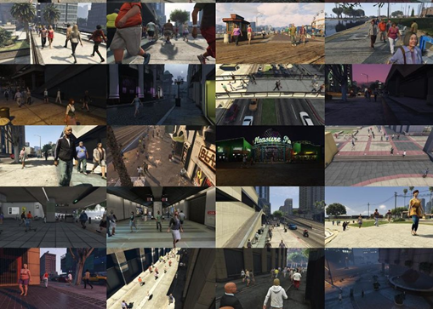
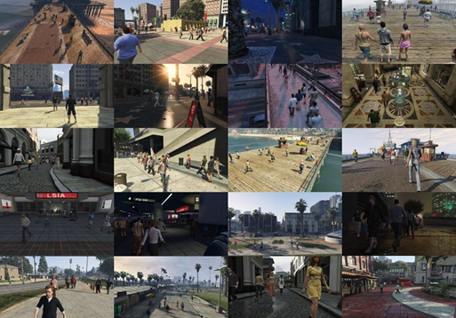
Methodology
Dataset (use online datasets)
Viper, GTA V
Preprocessing
Data Augmentation, Scale, 3D depth estimations.

Slide 14
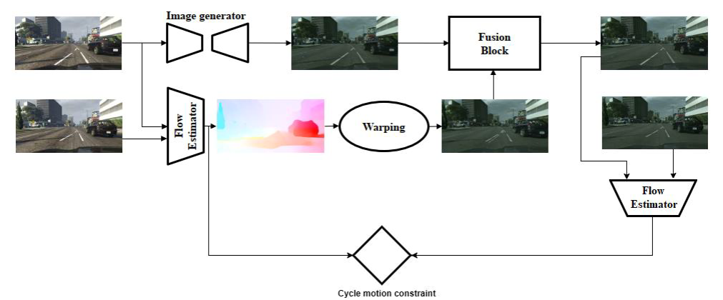
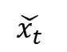

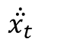
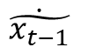
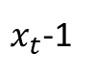
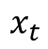
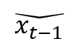
Conceptual framework
$$\dot{\ddot{x_{t}}}$$
$$x_{t}$$
$$\check{x_{t}}$$
$$\check{x_{t−1}}$$
$x_{t}$-1
$$\dot{\tilde{x_{t−1}}}$$
$$f_{t} is {(x}_{t}\text{, }x_{t+1}) \text{and} {f_{t rec}(x}_{t rec,}{ x}_{t rec+1})$$
$$such that f_{t} ≈ f_{t rec}$$

Slide 15
Scientific contribution
This work contribution
Temporal cycle consistency
Create architecture to Fusion Temporal cycle consistency with spatiotemporal information
Better color transformation

Slide 16
Application of results
Style transfer across multiple domain
Semantic segmentation.
Video super resolution
Color boosting and photo editing

Slide 17
Timetable
No. | Activities | Time
 |  | November | December | January | February | March | April | May | June
1 | Concept development and literature review
2 | Equipment and consumables purchase & Preprocessing
3 | Implementation of Deep learning model (Coding)
4 | Model Training
5 | Testing and Evaluation
6 | Conclusion and recommendation
7 | Documentation
8 | Final document submission

Slide 18
Budget plan
Resource Name | Amount | Unit Price in Birr | Total Price In Birr
Printing and Binding of Reports | 15 | 250 | 3750
Printing and Binding of Thesis | 4 | 600 | 2400
Stationary materials | 2 | 900 | 1800
Travel | 15 | 206 | 3090
GPU with power supply | 1 | 10,008 | 10,008
Data gathering Personnel | 3 | 3030 | 9090
Test Environment Construction Personnel | 6 | 1000 | 6000
Total |  |  | 40,148

Slide 19
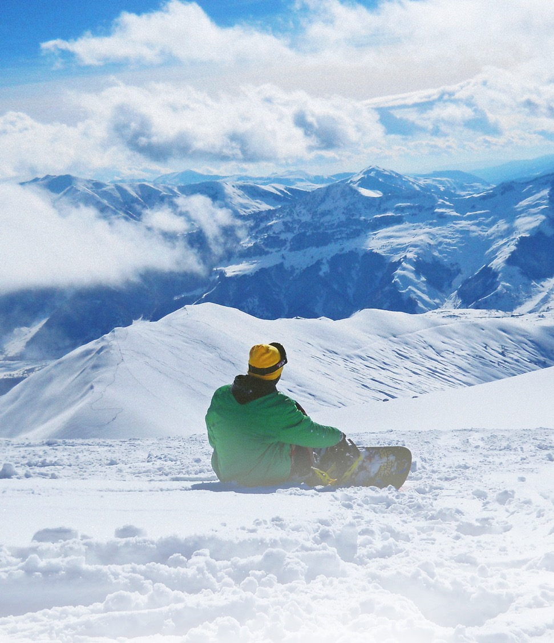



THANK YOU
thisiskiru@gmail.com
Kirubel Abebe
+(251) 914‐60 0429

Slide 20
